Slide 1

Department of Computer Science and Engineering Deep Learning Framework For Early Fire And Smoke Detection PRESENTED BY
Kata Ramya (21471A05N0)
Kota Supriya (22475A0519)
Chennupati Jyothika (21471A05M2)
Kondabathini Vydurya (18471A05k3)
Under the Guidance of,
Dr. Sireesha Moturi
Associate Professor
Department of Computer Science and Engineering,
Narasaraopeta Engineering College (Autonomous),
Narasaraopeta- 522 601.

Slide 2
OUTLINE
Abstract
Introduction
Literature Survey
Research Gaps
Problem Statement
Objectives
Block Diagram / Flow Diagram
Methodology
Implementation
Results and Analysis
Front End Screens
12.Conclusion & Future Scope
13.References
14.Question and Answers
15.Acknowledgements

Slide 3
ABSTRACT
Forest fires are a serious threat to both the environment and human life, causing significant ecological and economic damage. Traditional methods, like sensor-based systems, often detect fires too late to prevent major losses. This study focuses on using deep learning with pre-trained CNN models (VGG16, InceptionV3, and Xception) for early fire and smoke detection. By testing on dataset which was taken from the Kaggle ,the approach achieved impressive results, with InceptionV3 reaching 94% accuracy during feature extraction and 89% after fine-tuning. These results demonstrate the potential of CNN-based models to improve real-time fire detection and enhance rapid response efforts, reducing the devastating impact of forest fires.

Slide 4
INTRODUCTION
This project focuses on real-time fire and smoke detection in forests using Dense Net pre-trained models with transfer learning. Wavelet transform techniques are applied for image enhancement, improving detection accuracy and speed. The approach addresses environmental challenges by enhancing disaster response and reducing false alarms.
Wildfires threaten biodiversity, cause environmental damage, and result in economic losses. Traditional detection methods are unreliable, but deep learning models, especially pre-trained CNNs, offer accurate, real-time fire detection. This project integrates wavelet transform with dense pre-trained models to enhance detection speed and precision.

Slide 5
Importance
Wildfires are a major global issue, causing environmental destruction, loss of biodiversity, and economic damage. Effective fire detection is crucial to minimize these impacts by enabling timely responses and preventing escalation.
Relevance
Traditional methods are often inadequate, while advancements in deep learning, particularly pre-trained CNN models, provide robust and real-time solutions for fire and smoke detection. This project’s approach, combining transfer learning with wavelet image enhancement, is highly relevant for addressing these challenges efficiently in forest environments.

Slide 6
LITERATURE SURVEY
No | Title | Author | Journal Name & Year | Methodology Adapted | Key Findings | Gaps
1 | Forest fire and smoke detection using deep learning-based learning without forgetting | Sathishkumar, V.E., Cho, J., Subramanian, M. et al. | Springer and fire ecol 19, 9 (2023). https://doi.org/10.1186/s42408-022-00165-0 | Utilized CNNs (MobileNet, VGG16, ResNet50), transfer learning, and (LwF) | The study leverages CNNs, transfer learning, and LwF to enhance real-time forest fire and smoke detection for early warning systems. | The article lacks exploration of environmental factors, computational efficiency.
2 | Wildland Fire Detection and Monitoring Using a Drone-Collected RGB/IR Image Dataset | X. Chen et al., | IEEE Access, vol. 10(2022) 10.1109/ACCESS.2022.3222805. | UAV-dataset with deep learning techniques, particularly CNNs, for real-time wildland fire detection and monitoring. | wildland fire detection and monitoring using UAV-collected RGB and thermal images. | lacks exploration of environmental factors, computational efficiency,
3 | Forest-Fire Response System Using Deep-Learning-Based Approaches With CCTV Images and Weather Data. | Dai Quoc Tran | IEEE Access, vol. 10(2022) 10.1109/ACCESS.2022.3184707 | model that integrates CCTV images and weather data for early fire detection damage. | combining deep learning with CCTV images and weather data enhances the accuracy | lacks consideration of real-time processing challenges.

Slide 7
LITERATURE SURVEY
No | Title | Author | Journal Name & Year | Methodology Adapted | Key Findings | Gaps
4 | Energy-Efficient Deep CNN for Smoke Detection in Foggy IoT Environment | S. Khan, K. Muhammad, S. Mumtaz, S. W. Baik and V. H. C. de Albuquerque | IEEE Internet of Things Journal, vol. 6, no. 6, (Dec. 2019) 10.1109/JIOT.2019.2896120 | The article adapts an energy-efficient deep CNN model for smoke detection in both normal and foggy IoT environments. | deep CNNs significantly improve smoke detection accuracy in IoT environments, even under foggy conditions. | lacks consideration of real-time processing and the impact of diverse environmental conditions on detection
5 | An Attention Enhanced Bidirectional LSTM for Early Forest Fire Smoke Recognition | Y. Cao, F. Yang, Q. Tang and X. Lu | IEEE Access, vol. 7(2019) 10.1109/ACCESS.2019.2946712 | Enhanced Bidirectional Long Short-Term Memory Network (ABi-LSTM) designed for video-based forest fire smoke detection | ABi-LSTM model achieves a high accuracy of 97.8%, marking a 4.4% improvement over traditional image-based deep learning models | comparison with non-deep learning methods for broader applicability

Slide 8
RESEARCH GAPS
Dataset Limitations:
Limited dataset size or quality can hinder model performance and generalizability. Insufficient diversity within datasets leads to biased predictions.
Cross-Validation:
A technique to split data into training and validation sets, ensuring robust evaluation of the model. It helps detect overfitting and provides a better estimate of performance.
Interpretability:
Refers to understanding the decision-making process of AI models. Enhancing interpretability builds trust and aids in debugging complex systems.
Data Diversity:
Ensuring varied data sources enhances model robustness and reduces bias. Diverse datasets help models perform better across different real-world scenarios.

Slide 9
PROBLEM STATEMENT
Wildfires pose significant threats to ecological balance, biodiversity, and human safety. Traditional fire and smoke detection methods, such as sensor-based systems and manual visual inspections, are often inefficient and prone to false alarms, limiting their reliability in real-time scenarios.
There is a critical need for a robust, accurate, and efficient detection system that can rapidly identify and respond to fire outbreaks, minimizing damage and enabling better disaster management. This project aims to address these challenges using deep learning techniques, leveraging pre-trained convolutional neural networks for enhanced accuracy and real-time performance in forest fire and smoke detection.

Slide 10
OBJECTIVES
To develop an automated system for real-time detection of forest fires and smoke using deep learning techniques.
To enhance the accuracy of fire and smoke detection by utilizing pre-trained CNN models like VGG16, InceptionV3, and Xception.
To implement transfer learning to improve detection efficiency with limited data.
To evaluate and compare the performance of different CNN models in terms of detection accuracy and response time.
To create a robust solution for aiding in early fire detection, thereby improving disaster management and resource allocation.

Slide 11
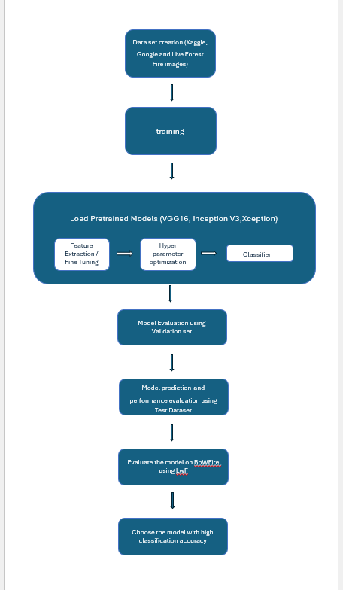
BLOCK DIAGRAM

Slide 12
METHODOLOGY
Data Collection Gathered data from multiple sources, including Google, Kaggle datasets (wildfire smoke dataset, Data Cluster Labs fire and smoke dataset), and satellite imagery of forest fires. Manual labelling was applied to classify images into Fire, No Fire, Smoke, and Smoke Fire categories.
Preprocessing Performed data augmentation to balance dataset classes and enhance model training. Augmentation techniques included flipping, rotation, zoom, and color adjustments. Converted images to a uniform resolution for consistency.
Model Development Developed an ensemble of pre-trained CNN models (VGG16, InceptionV3, Xception) using transfer learning to improve detection accuracy. Fine-tuned each model on the augmented dataset to optimize performance.

Slide 13
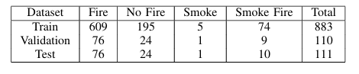
METHODOLOGY
DATA COLLECTION
The dataset for fire detection was created by combining images from various sources, including Kaggle datasets, Google Images, and live forest fire imagery. It contains four categories: Fire, Non-Fire, Smoke, and Smoke-Fire.

Slide 14
METHODOLOGY
Data Preprocessing
Resizing Images:
All images are resized to a uniform dimension to ensure compatibility with deep learning models like VGG16, InceptionV3, and Xception.
Normalization:
Pixel values are scaled to a range of 0 to 1, improving computational efficiency and ensuring faster convergence during model training.
Data Augmentation:
To enhance the diversity and balance of the dataset, the following augmentation techniques were applied:
Rotations: Rotating images at different angles to simulate various perspectives.
Flipping: Applying horizontal and vertical flips to generate new variations.
Brightness Adjustment: Modifying brightness levels to account for lighting variations.

Slide 15
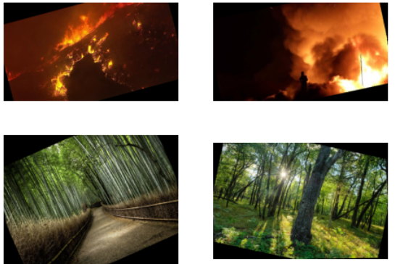
METHODOLOGY
Feature Extraction: Pre-trained models such as VGG16, InceptionV3, and Xception are leveraged to extract meaningful features from the images. These models act as fixed feature extractors, capturing essential patterns, textures, and representations while reducing the need for extensive manual feature engineering.

Slide 16
METHODOLOGY
Splitting the Dataset
The fire dataset was divided into training, validation, and testing sets to facilitate model training and evaluation. The split was performed based on the class labels in the dataset, which include "Fire," "Smoke," "Non-Fire," and "Fire Smoke.”
The dataset split was carefully balanced to address class imbalances:
Train (80%): Includes the majority of the dataset to ensure robust learning.
Validation (10%): Used for fine-tuning and hyperparameter optimization.
Test (10%): Used exclusively for final performance evaluation.
This approach ensures a representative and unbiased division, enabling the model to generalize well on unseen data while overcoming class imbalance challenges.

Slide 17
METHODOLOGY
Building the Model Architecture
Initially, pre-trained layers were frozen, and only custom layers were trained.
Pre-trained models VGG16, InceptionV3, and Xception were used with their top layers removed.
Custom layers included Global Average Pooling, dense layers with ELU activation, dropout, and a soft max output layer.
Input sizes: VGG16 (224x224), InceptionV3 and Xception (299x299).
In the fine-tuning phase, selected layers of the base models were unfrozen and trained with a reduced learning rate.
The Adam optimizer and categorical cross entropy loss were used for effective training.
This process ensured robust feature extraction and model adaptation to the fire image dataset.

Slide 18
METHODOLOGY
Training the Model on the Training Dataset
Hyperparameters such as learning rate, batch size, and number of epochs were carefully optimized to ensure efficient convergence and prevent overfitting.
The categorical cross entropy loss function was used, suitable for multi-class classification tasks.
The Adam optimizer was employed with a learning rate scheduler to dynamically adjust the learning rate, enhancing both training speed and accuracy.
Metrics such as training and validation loss, along with accuracy, were monitored during each epoch to track progress and guide adjustments as needed.
Early stopping was implemented based on validation performance to avoid overfitting and improve model generalization.

Slide 19
IMPLEMENTATION
Software Specifications:
Programming Language: Python (version 3.x).
Deep Learning Framework: TensorFlow and Keras.
Libraries: NumPy, OpenCV, Matplotlib, and Scikit-learn.
Platform: Google Colab for leveraging GPU/TPU support.
Visualization: Matplotlib and Seaborn for visualizing model performance.
Hardware Specifications:
GPU: NVIDIA Tesla K80 (provided by Google Colab).
RAM: 12GB.
Storage: 50GB cloud storage on Google Drive.
Challenges Faced:
Class Imbalance: The dataset had a limited number of images in some classes.
Solution: Applied data augmentation techniques such as flipping, rotation, and scaling to increase dataset variability.

Slide 20
IMPLEMENTATION
Model development:
Base Models:
Pre-trained VGG16, InceptionV3, and Xception were loaded without their top layers to leverage their feature extraction capabilities.
Custom Layers:
A Global Average Pooling layer was added to reduce dimensionality.
Dense layers with ELU activation were introduced to learn complex patterns.
A final soft max layer was added for multi-class classification.
Fine-tuning:
Initially, the base layers of the models were frozen to retain their pre-trained knowledge.
During fine-tuning, these layers were unfrozen, and the entire network was trained with a low learning rate to optimize performance.
Training Configurations:
Data augmentation techniques were used to enhance the diversity of training data.
The Adam optimizer with a learning rate of 0.0001 was employed.

Slide 21
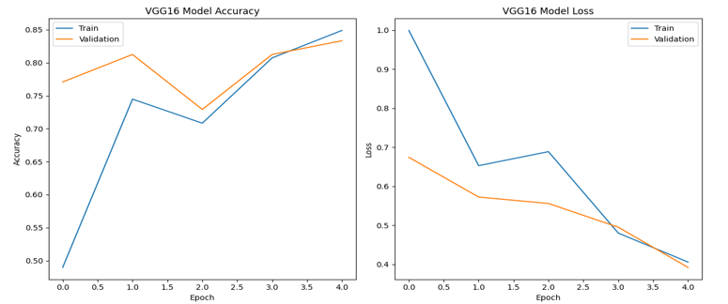
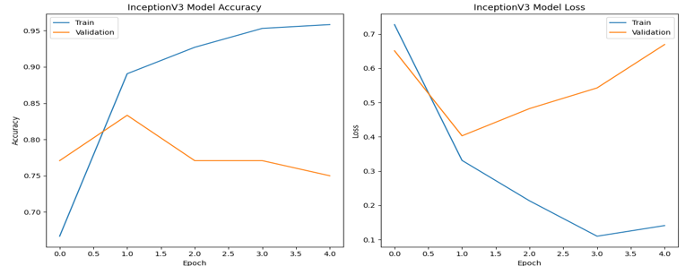
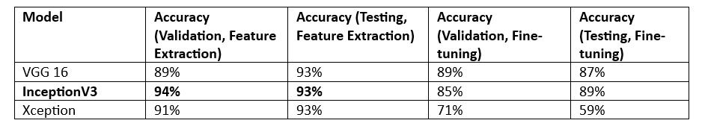
RESULTS & ANALYSIS
Fig: Accuracy and Loss Curves for VGG 16,Inception V3
Fig: Accuracy Table

Slide 22
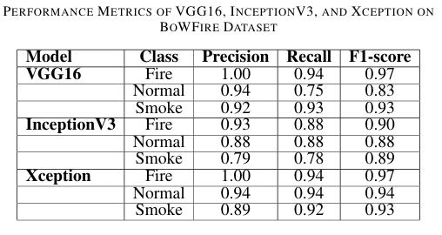
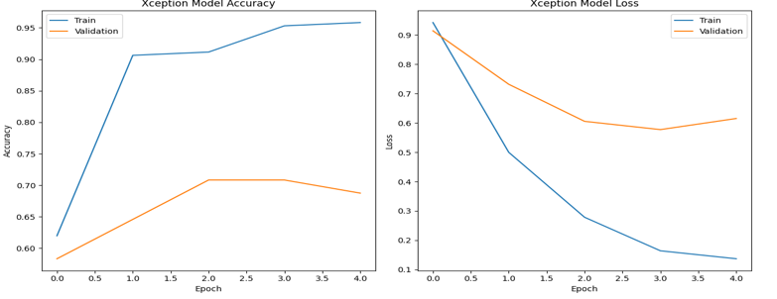
RESULTS & ANALYSIS
Fig: Accuracy and Loss Curves for Xception

Slide 23
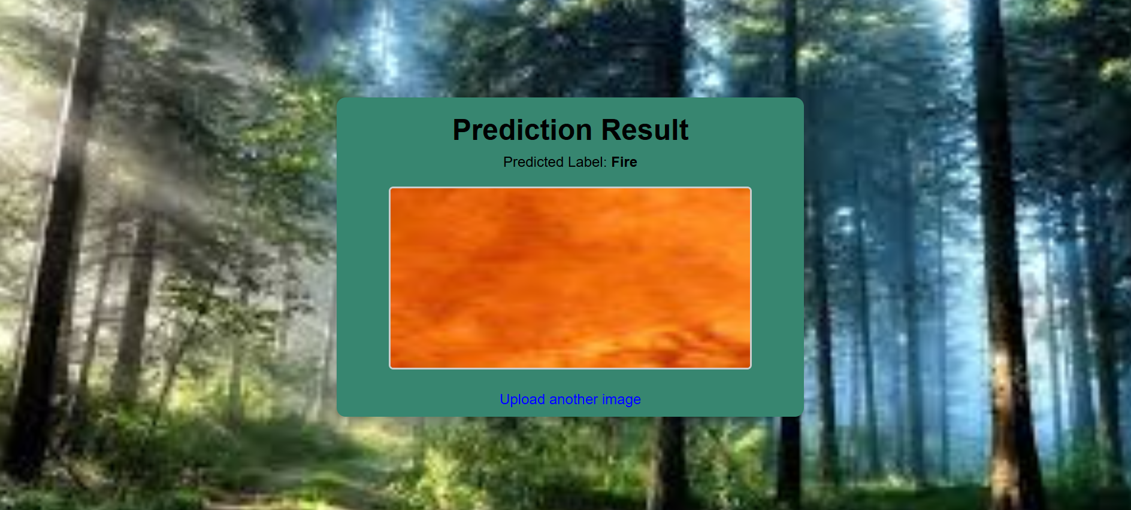
Front End Screens
Fig : Test Case of Fire Image
The image illustrates the model's capability to accurately detect fire, which is crucial for early warning systems and disaster prevention.

Slide 24
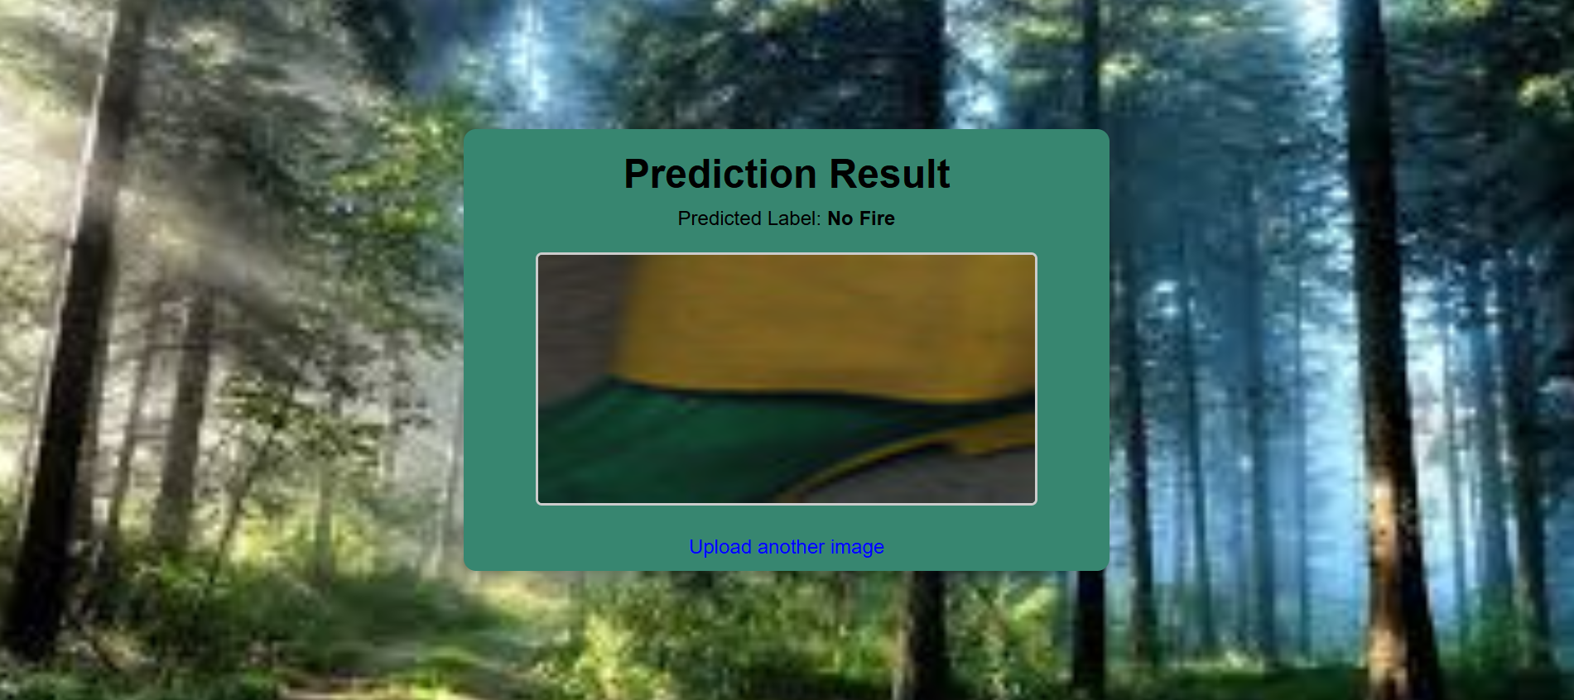
Front End Screens
Fig : Test Case of No Fire Image
The image showcases the system's ability to distinguish non-fire elements, ensuring minimal false positives and improving overall reliability.

Slide 25
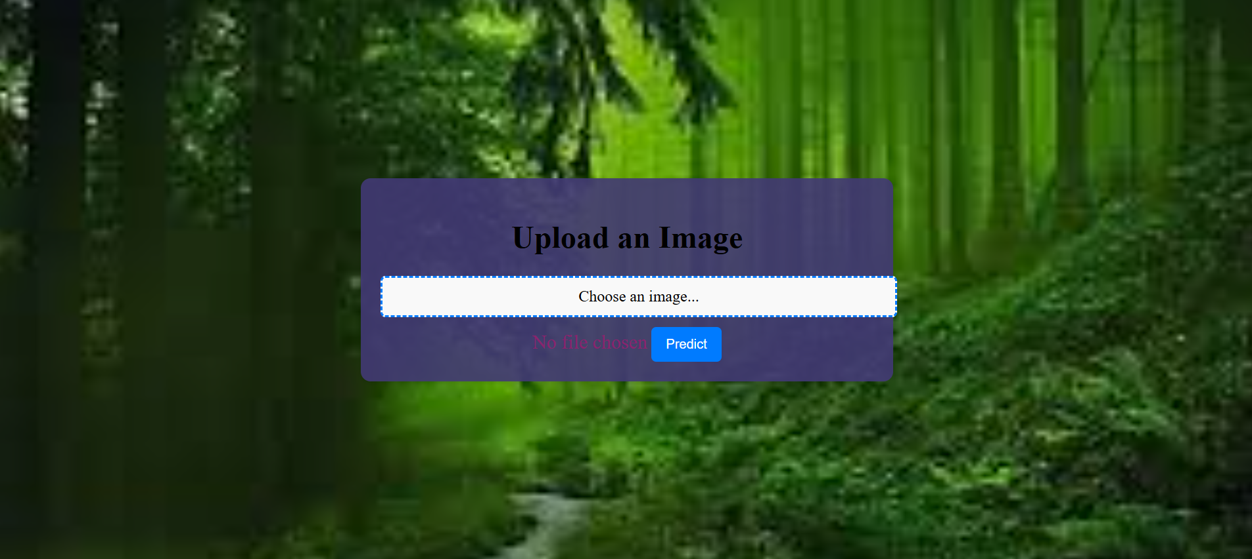
Front End Screens
Fig : Prediction Screen
The Upload Screen allows users to select and upload an image for fire and smoke detection. Once an image is chosen, clicking the Predict button initiates the classification process.

Slide 26
CONCLUSION and FUTURE SCOPE
The proposed model effectively detects fire and smoke with high accuracy using deep learning architectures.
Transfer learning techniques demonstrated improved performance in classifying images across fire-related categories.
The model outperformed existing methods, confirming its robustness and reliability for real-time fire detection.
Explore Multi-Modal Approaches:
Incorporate thermal imaging along with visible spectrum images for improved detection accuracy in various conditions.
Real-Time Implementation:
Deploy the model on edge devices for immediate fire detection in diverse environments.
3D Convolutional Networks:
Extend the model to 3D CNNs to analyze volumetric data for a deeper understanding of fire dynamics.

Slide 27
REFERENCES
X. Chen et al. "Wildland Fire Detection and Monitoring Using a Drone-Collected RGB/IR Image Dataset." IEEE Access, vol. 10, pp. 121301-121317, 2022. https://doi.org/10.1109/ACCESS.2022.3222805
D. Q. Tran, M. Park, Y. Jeon, J. Bak, and S. Park. "Forest-Fire Response System Using Deep-Learning-Based Approaches With CCTV Images and Weather Data." IEEE Access, vol. 10, pp. 66061-66071, 2022. https://doi.org/10.1109/ACCESS.2022.3184707
M. Gonçalves, T. Brandão, and J. C. Ferreira. "Wildfire Detection With Deep Learning—A Case Study for the CICLOPE Project." IEEE Access, vol. 12, pp. 82095-82110, 2024. https://doi.org/10.1109/ACCESS.2024.3406215
D. Rashkovetsky, F. Mauracher, M. Langer, and M. Schmitt. "Wildfire Detection From Multisensor Satellite Imagery Using Deep Semantic Segmentation." IEEE Journal of Selected Topics in Applied Earth Observations and Remote Sensing, vol. 14, pp. 7001-7016, 2021. https://doi.org/10.1109/JSTARS.2021.3093625
Mishra, B., Panthi, S., Poudel, S. et al. "Forest fire pattern and vulnerability mapping using deep learning in Nepal." Fire Ecology 19, 3 (2023). https://doi.org/10.1186/s42408-022-00162-3

Slide 28
REFERENCES
L. Wang, H. Zhang, Y. Zhang, K. Hu, and K. An. "A Deep Learning-Based Experiment on Forest Wildfire Detection in Machine Vision Course." IEEE Access, vol. 11, pp. 32671-32681, 2023. https://doi.org/10.1109/ACCESS.2023.3262701
C. Chaoxia, W. Shang, and F. Zhang. "Information-Guided Flame Detection Based on Faster R-CNN." IEEE Access, vol. 8, pp. 58923-58932, 2020. https://doi.org/10.1109/ACCESS.2020.2982994
G. Wang, J. Li, Y. Zheng, Q. Long, and W. Gu. "Forest smoke detection based on deep learning and background modeling." 2020 IEEE International Conference on Power.
aLWang, H. Zhang, Y. Zhang, K. Hu, and K. An. "A Deep Learning-Based Experiment on Forest Wildfire Detection in Machine Vision Course." IEEE Access, vol. 11, pp. 32671-32681, 2023. https://doi.org/10.1109/ACCESS.2023.3262701
C. Chaoxia, W. Shang, and F. Zhang. "Information-Guided Flame Detection Based on Faster R-CNN." IEEE Access, vol. 8, pp. 58923-58932, 2020. https://doi.org/10.1109/ACCESS.2020.2982994

Slide 29

QUESTIONS and ANSWERS

Slide 30
ACKNOWLEDGEMENT
Thank you all for giving me the opportunity to present our project,
Deep Learning Framework For
Early Fire And Smoke Detection
If you have any further questions, need additional information
Contact Information:
Phone Number: 9392610189
Email: kataramya29@gmail.com
Phone Number: 8688424199
Email: jyothikachennupati19@gmail.com
Phone Number: 7331102293
Email: supriyakotareddy@gmail.com
Phone Number: 9014782943
Email: 18471A05K3@nrtec.in

